Slide 1
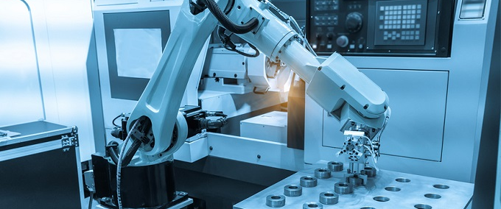
Servos
And their use in robotics

Slide 2
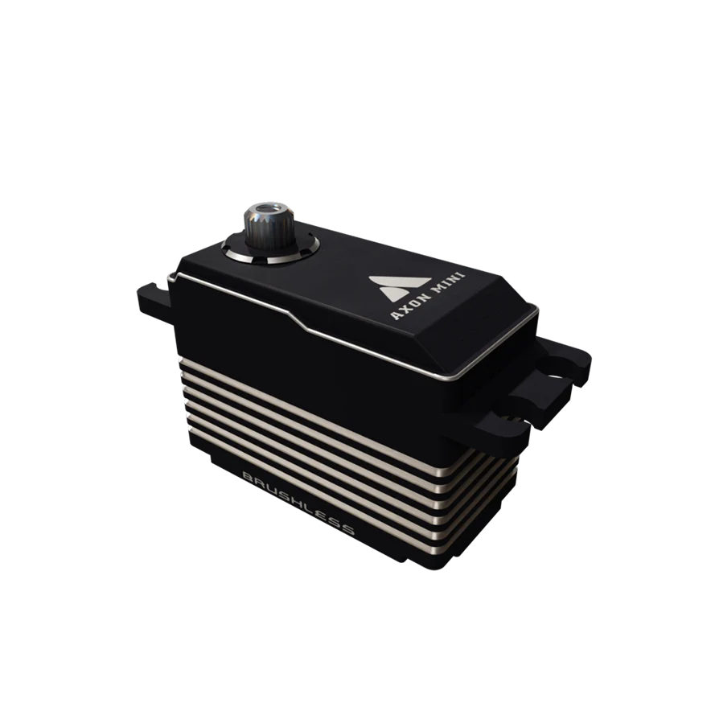
What is a Servo
A servo is a motor with built-in feedback for precise position control
Moves to and holds specific angles (e.g., 0° to 180°)
Controlled by setting a position value, not speed or power
Ideal for claws, arms, gates, and linear actuators

Slide 3
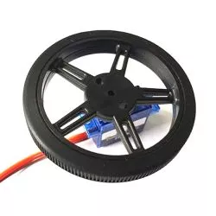
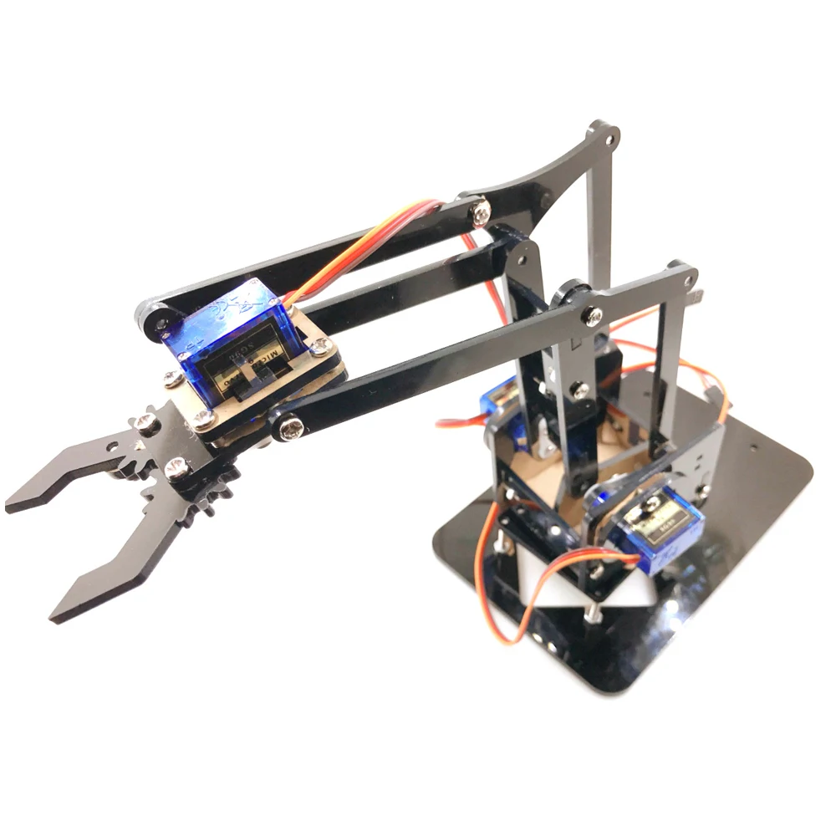
Types of Servos
Standard Servos
  Limited range (typically 0° to 180°)
  Used for arms, claws, levers
Continuous Rotation Servos (CR Servos)
  Behave like DC motors
  Control speed and direction, not position
  Used for low-power drive systems or rollers
Many servos support both modes

Slide 4
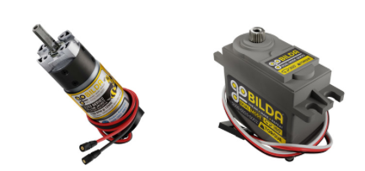
Servos vs DC Motors
Feature | DC Motor | Servo
Control Type | Power (speed & direction) | Position (angle)
Feedback | Needs external encoder | Built-in
Range | Continuous rotation | Limited (std servos)
Best For | High-speed motion | Precision movements

Slide 5
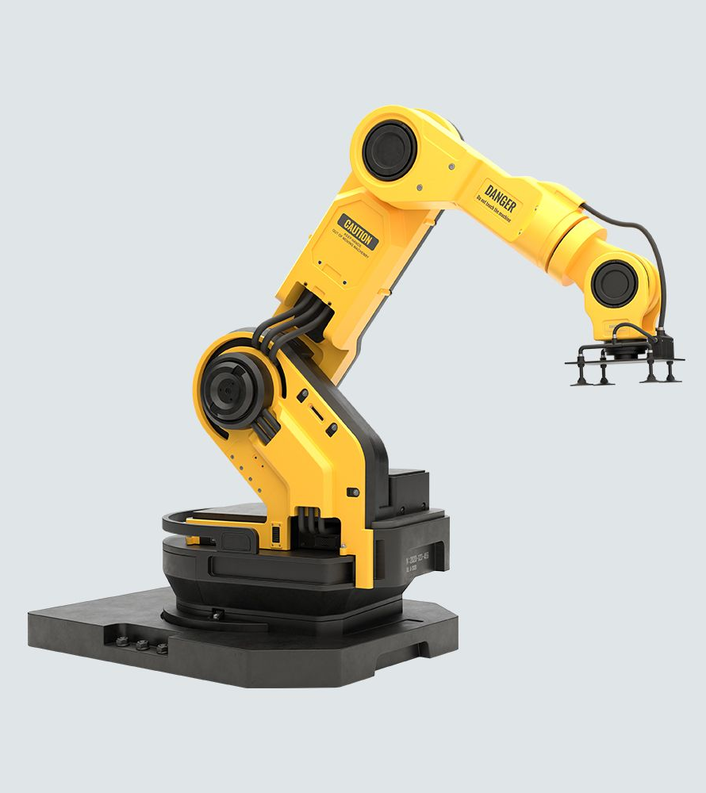
Application
Claws/Grippers → open/close accurately
Arm Joints → set angles for pick-and-place
Latches/Gates → control cargo flow
Linear actuators → push/pull mechanisms
Marker dropping, trap doors, toggles

Slide 6
Programming Standard Servos
Set position from 0.0 to 1.0 (scaled to angle)
0.0 = one extreme, 1.0 = opposite extreme
Notes:
Servo servo = hardwareMap.get(Servo.class, "clawServo");
servo.setPosition(0.5); // move to mid-position0.0 = one extreme, 1.0 = opposite extreme

Slide 7

Programming CRServos
Behaves like a motor, with continuous rotation
Use for spinning, intake, low-load movement
Notes:
Servo servo = hardwareMap.get(Servo.class, "clawServo");
servo.setPosition(0.5); // move to mid-position0.0 = one extreme, 1.0 = opposite extreme

Slide 8
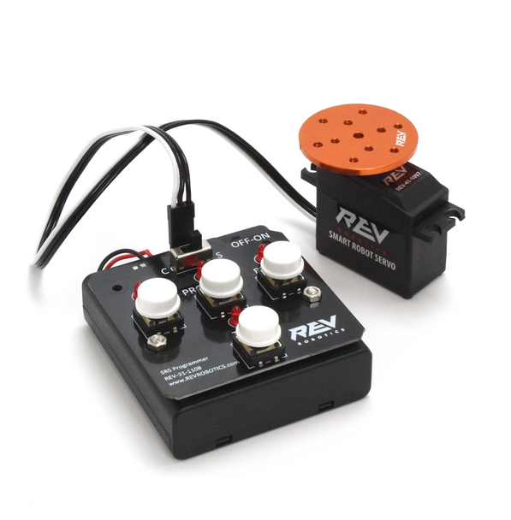
Servo Programmer
A servo programmer helps test and set servo positions without a robot controller
Plug in a standard servo and use the dial or buttons to:
  Manually rotate to a specific position
  Test range of motion before installing
  Center the servo before mounting
Great for:
  Troubleshooting
  Pre-alignment
  Testing unknown or third-party servos

Slide 9
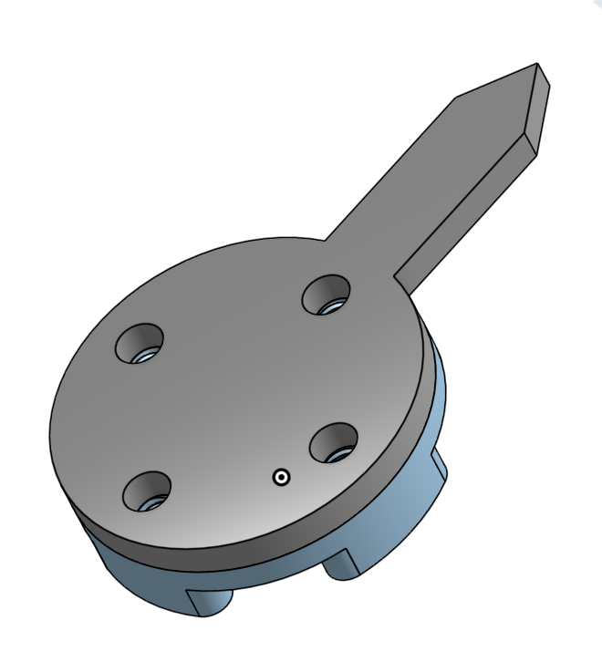
Program a Servo Clock
Use the provided 3D Printed Clock
Start at 12 o’clock
Move to 5 o’clock

Slide 10
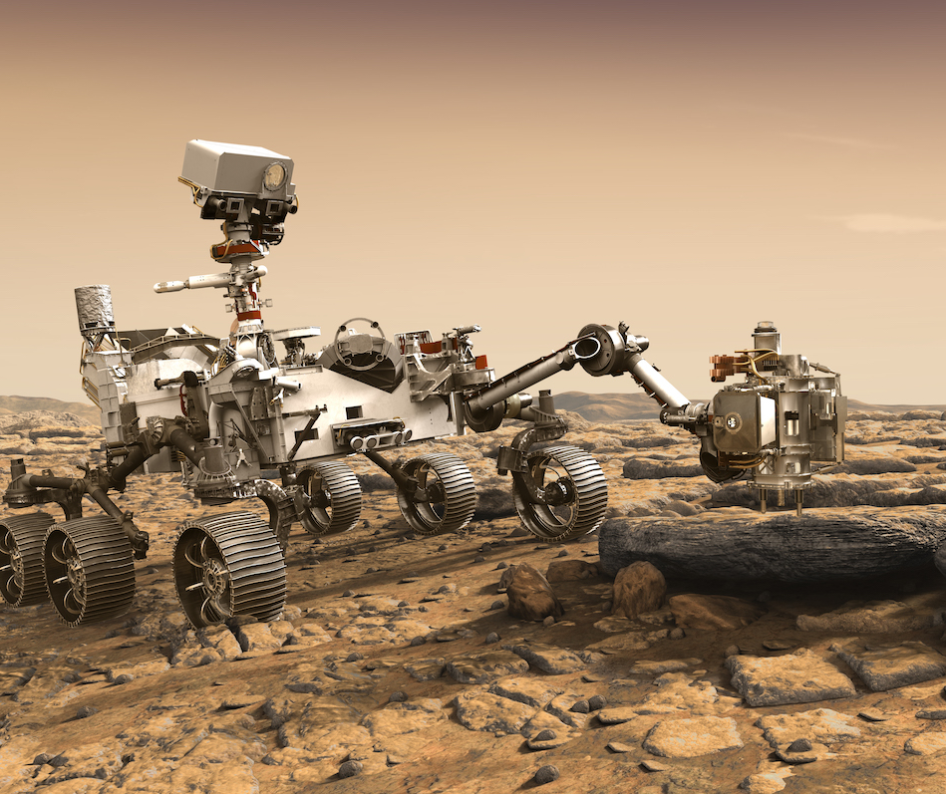
Build a Rover Arm
Build a servo-based arm for Mars sample collection

